Slide 1



Targeted Metabolomics Data Analysis: Unlocking Insights with Machine Learning, AI and Statistics
Wishart Node
Day 1 – Lecture 3.1b
June 11-14, 2024
Barcelona, Spain

Slide 2
Agenda (Day 3)
Time | Activity
8:30 – 9;00 | Arrival
9:00 – 10:30 | Statistics Review
10:30 – 11:00 | Coffee
11:00 – 13:00 | Machine Learning Methods and Metabolomics
13:00 – 14:00 | Lunch
14:00 – 15:30 | Introduction to MetaboAnalyst
15:30 – 16:00 pm | Coffee
16:00 – 17:00 pm | Lab: Analyzing MEGA Data with MetaboAnalyst

Slide 3
Outline
The class comparison problem
Statistical tests
Calculation of p-values
Permutations tests
The volcano plot
Multiple testing
Examples

Slide 4
Class comparison: Identifying significantly different features
Identify metabolites whose expression is significantly associated with different conditions
Treatment, cell type,... (qualitative covariates)
Dose, time, ... (quantitative covariate)
Survival, infection time,... !
Estimate effects/differences between groups probably using log-ratios, i.e. the difference on log scale: log(X)-log(Y) [=log(X/Y)]

Slide 5
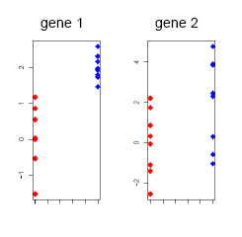
What is a “significant change”?
Depends on the variability within groups, which may be different from feature to feature.
To assess the statistical significance of differences, conduct a statistical test for each feature.

Slide 6
Different settings for statistical tests
Indirect comparisons: 2 groups, 2 samples, unpaired
E.g. 10 individuals: 5 suffer diabetes, 5 healthy
One sample fro each individual
Typically: Two sample t-test or similar
Direct comparisons: Two groups, two samples, paired
E.g. 6 individuals with brain stroke.
Two samples from each: one from healthy (region 1) and one from affected (region 2).
Typically: One sample t-test (also called paired t-test) or similar, based on the individual differences between conditions.

Slide 7
“Natural” measures of discrepancy
For direct comparisons (based on ratios)
For indirect comparisons based on differences

Slide 8
Some issues in feature selection
Each technology’s data may have peculiarities that have to be dealt with.
Some related with small sample sizes
Variance unstability
Non-normality of the data
Other related to big number of variables
Multiple testing

Slide 9
Variance unstability
Can we trust average effect sizes (average difference of means) alone?
Can we trust the t-statistic alone?
Here is evidence that the answer is no.
Gene | M1 | M2 | M3 | M4 | M5 | M6 | Mean | SD | t
A | 2.5 | 2.7 | 2.5 | 2.8 | 3.2 | 2 | 2.61 | 0.40 | 16.10
B | 0.01 | 0.05 | -0.05 | 0.01 | 0 | 0 | 0.003 | 0.03 | 0.25
C | 2.5 | 2.7 | 2.5 | 1.8 | 20 | 1 | 5.08 | 7.34 | 1.69
D | 0.5 | 0 | 0.2 | 0.1 | -0.3 | 0.3 | 0.13 | 0.27 | 1.19
E | 0.1 | 0.11 | 0.1 | 0.1 | 0.11 | 0.09 | 0.10 | 0.01 | 33.09
M may be assumed to be the log-Fold change in a paired experiment

Slide 10
Variance unstability (1): outliers
Can we trust average effect sizes (average difference of means) alone?
Can we trust the t statistic alone?
Here is evidence that the answer is no.
Gene | M1 | M2 | M3 | M4 | M5 | M6 | Mean | SD | t
A | 2.5 | 2.7 | 2.5 | 2.8 | 3.2 | 2 | 2.61 | 0.40 | 16.10
B | 0.01 | 0.05 | -0.05 | 0.01 | 0 | 0 | 0.003 | 0.03 | 0.25
C | 2.5 | 2.7 | 2.5 | 1.8 | 20 | 1 | 5.08 | 7.34 | 1.69
D | 0.5 | 0 | 0.2 | 0.1 | -0.3 | 0.3 | 0.13 | 0.27 | 1.19
E | 0.1 | 0.11 | 0.1 | 0.1 | 0.11 | 0.09 | 0.10 | 0.01 | 33.09
Averages can be driven by outliers.

Slide 11
Variance unstability (2): tiny variances
Can we trust average effect sizes (average difference of means) alone?
Can we trust the t statistic alone?
Here is evidence that the answer is no.
Gene | M1 | M2 | M3 | M4 | M5 | M6 | Mean | SD | t
A | 2.5 | 2.7 | 2.5 | 2.8 | 3.2 | 2 | 2.61 | 0.40 | 16.10
B | 0.01 | 0.05 | -0.05 | 0.01 | 0 | 0 | 0.003 | 0.03 | 0.25
C | 2.5 | 2.7 | 2.5 | 1.8 | 20 | 1 | 5.08 | 7.34 | 1.69
D | 0.5 | 0 | 0.2 | 0.1 | -0.3 | 0.3 | 0.13 | 0.27 | 1.19
E | 0.1 | 0.11 | 0.1 | 0.1 | 0.11 | 0.09 | 0.10 | 0.01 | 33.09
t’s can be driven by tiny variances.

Slide 12
Solutions: Adapt t-tests
Let
R_{g} mean observed log ratio
SE_{g} standard error of R_{g} estimated from data on gene g.
SE standard error of R_{g} estimated from data across all genes.
Global t-test: t=R_{g}/SE
Gene-specific t-test t=R_{g}/SE_{g}

Slide 13
Some pro’s and con’s of t-test
Test | Pro’s | Con’s
Global t-test: t=R_{g}/SE | Yields stable variance estimate | Assumes variance homogeneity → biased if false
Gene-specific: t=R_{g}/SE_{g} | Robust to variance heterogeneity | Low power Yields unstable variance estimates (due to few data)

Slide 14
T-tests extensions
SAM (Tibshirani, 2001)
Regularized-t
(Baldi, 2001)
EB-moderated t
(Smyth, 2003)

Slide 15
Up to here…: Can we generate a list of candidate features?
With the tools we have, the reasonable steps to generate a list of candidate features may be:
Feature 1: M₁₁, M₁₂, …., M_{1k}
Feature 2: M₂₁, M₂₂, …., M_{2k}
…………….
Feature G: M_{G1}, M_{G2}, …., M_{Gk}
For every feature, calculate S_{i}=t(M_{i1}, M_{i2}, …., M_{ik}),
e.g. t-statistics, S, B,…
?
Statistics of interest S₁, S₂, …., S_{G}
A list ofcandidate significant features
We need an idea of how significant are these values →We’d like to assign them p-values

Slide 16
Nominal p-values
After a test statistic is computed, it is convenient to convert it to a p-value: The probability that a test statistic, say S(X), takes values equal or greater than the observed value, say X^{0,} under the assumption that the null hypothesis is true p=P{S(X)>=S(X⁰)|H₀ true}

Slide 17
Significance testing
Test of significance at the α level:
Reject the null hypothesis if your p-value is smaller than the significance level
It has advantages but not free from criticisms
Genes with p-values falling below a prescribed level may be regarded as significant

Slide 18
Hypothesis testing overview for a single feature
 |  | Reported decision
 |  | H₀ is Accepted (feature not Selected) | H₀ is Rejected (feature is Selected)
State of the nature ("Truth") | H₀ is true (Not really Affected) | TN , prob: β | FP, P[Rej H₀|H₀]<= α Type I error | Specificity TN/[TN+FP]
 | H₀ is false (Affected) | FN, prob: 1-β Type II error | TP, prob: 1-α | Sensitiviy TP/[TP+FN]
 |  | Negative predictive value TN/[TN+FN] | Positive predictive value TP/[TP+FP]

Slide 19
Calculation of p-values
Standard methods for calculating p-values:
(i) Refer to a statistical distribution table (Normal, t, F, …) or
(ii) Perform a permutation analysis

Slide 20
(i) Tabulated p-values
Tabulated p-values can be obtained for standard test statistics (e.g.the t-test)
They often rely on the assumption of normally distributed errors in the data
This assumption can be checked (approximately) using a
Histogram
Q-Q plot
Notes:
One of the things we want to do with our t-statistics is roughly speaking, to identify the extreme ones.
It is natural to rank them, but how extreme is extreme? Since the sample sizes here are not too small ( two samples of 8 each gives 16 terms in the difference of the means), approximate normality is not an unreasonable expectation for the null marginal distribution.
Converting ranked t’s into a normal q-q plot is a great way to see the extremes: they are the ones that are “off the line”, at one end or another. This technique is particularly helpful when we have thousands of values. Of course we can’t expect all differentially expressed genes to stand out as extremes: many will be masked by more extreme random variation, which is a big problem in this context.

Slide 21
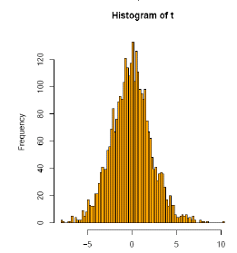
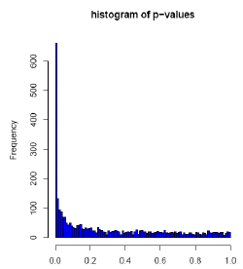
Example (1)
Two groups 27 A vs 11 B samples, 3051 features
A t-test yields 1045 features with p< 0.05

Slide 22
(ii) Permutations tests
Based on data shuffling. No assumptions
Random interchange of labels between samples
Estimate p-values for each comparison (feature) by using the permutation distribution of the t-statistics
Repeat for every possible permutation, b=1…B
Permute the n data points for feature (x). The first n₁ are referred to as “treatments”, the second n₂ as “controls”
For each gene, calculate the corresponding two sample t-statistic, t_{b}
After all the B permutations are done put p = #{b: |t_{b}| ≥ |tobserved|}/B

Slide 23
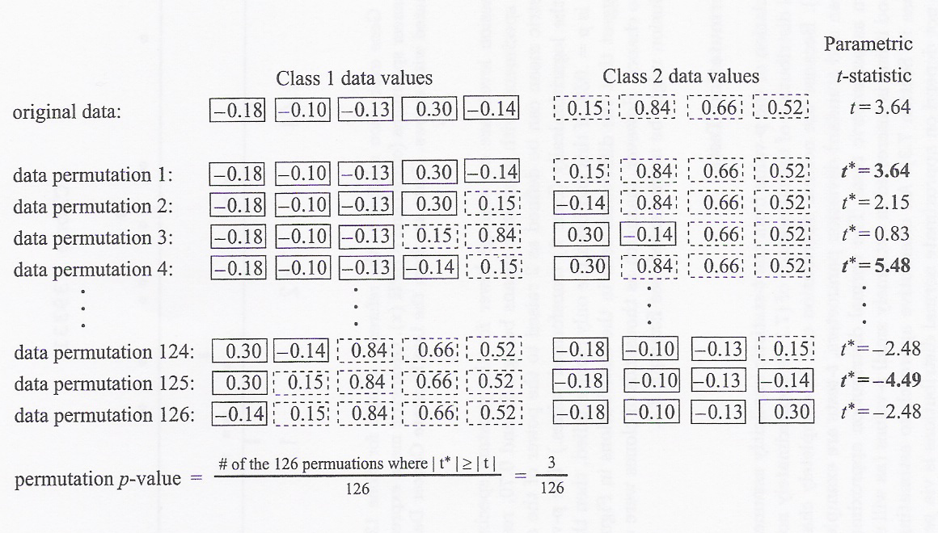
Permutation tests (2)

Slide 24
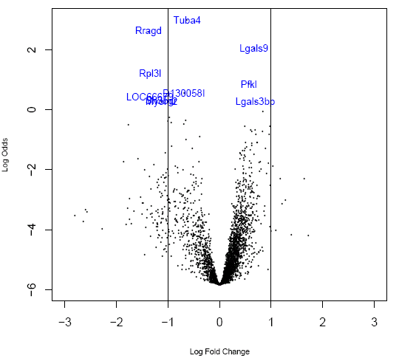
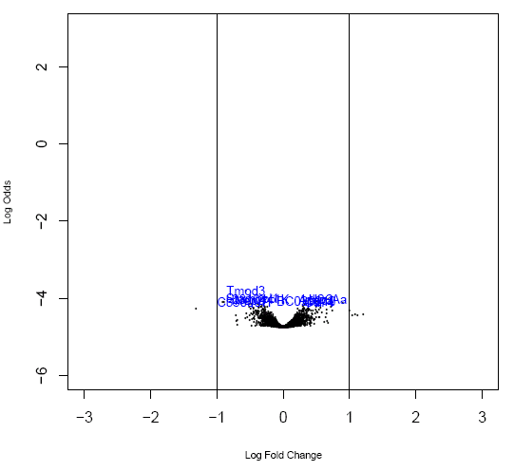
The volcano plot: fold change vs log(odds)¹
Significant change detected
No change detected
1: log(odds) is proportional to “-log (p-value)”

Slide 25
Multiple testing

Slide 26
How far can we trust the decision?
The test: "Reject H₀ if p-val ≤ α"
is said to control the type I error because, under a certain set of assumptions, the probability of falsely rejecting H₀ is less than a fixed small threshold
P[Reject H₀|H₀ true]=P[FP] ≤ α
Nothing is warranted about P[FN]→
“Optimal” tests are built trying to minimize this probability
In practical situations it is often high

Slide 27
What if we wish to test more than one gene at once? (1)
Consider more than one test at once
Two tests each at 5% level. Now probability of getting a false positive is 1 – 0.95*0.95 = 0.0975
Three tests → 1 – 0.95³ =0.1426
n tests → 1 – 0.95^{n}
Converge towards 1 as n increases
Small p-values don’t necessarily imply significance!!! → We are not controlling the probability of type I error anymore

Slide 28
What if we wish to test more than one gene at once? (2): a simulation
Simulation of this process for 6,000 features with 8 treatments and 8 controls
All the gene expression values were simulated i.i.d from a N (0,1) distribution, i.e. NOTHING is significantly different expressed in our simulation
The number of features falsely identified as distinct will be on the average of (6000 · α), i.e. if we wanted to reject all genes with a p-value of less than 1% we would falsely reject around 60 genes
See example

Slide 29
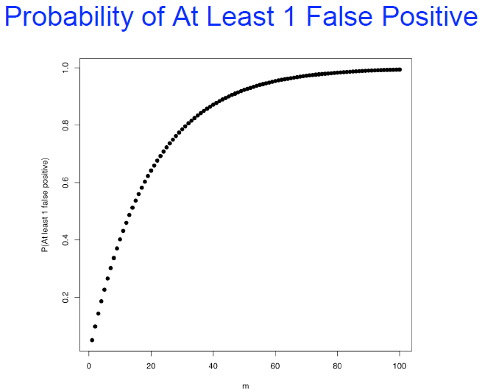
Type I error not useful in multiple testing
Number of tests: m | P(making at least a type I error) = 1-(1- a)^{m}
1 | 0.050000
2 | 0.097500
3 | 0.142625
4 | 0.185494
5 | 0.226219
6 | 0.264908
7 | 0.301663
8 | 0.336580

Slide 30
Multiple testing: Counting errors
 |  | Decision reported
 |  | H₀ is accepted (Genes not Selected) |  | H₀ is Rejected (Genes Selected) |  | Total
State of the nature ("Truth") | H₀ is true (Not Affected) | m_{o}-αm0 | (U) | αm₀ | (V) | m_{o}
 | H₀ is false (Affected) | (m-m_{o})- (m_{α} −αm₀₎ | (T) | m_{α} −αm₀ | (S) | m-m_{o}
Total |  | m-m_{α} | (m-R) | M_{α} | (R) | m
V = # Type I errors [false positives]
T = # Type II errors [false negatives]
All these quantities could be known if m₀ was known

Slide 31
How does type I error control extend to multiple testing situations?
Selecting genes with a p-value less than α doesn’t control for P[FP] anymore
What can be done?
Extend the idea of type I error
FWER and FDR are two such extensions
Look for procedures that control the probability for these extended error types
Mainly adjust raw p-values
Notes:
For strong control of the FWER at some level α, there are procedures which will take m unadjusted p-values and modify them separately, so-called single step procedures, the Bonferroni adjustment or correction being the simplest and most well known. Another is due to Sidák.
Other, more powerful procedures, adjust sequentially, from the smallest to the largest, or vice versa. These are the step-up and step-down methods, and we’ll meet a number of these, usually variations on single-step procedures.

Slide 32
Two main error rate extensions
Family Wise Error Rate (FWER)
FWER is probability of at least one false positive
FWER= Pr(# of false discoveries >0) = Pr(V>0)
False Discovery Rate (FDR)
FDR is expected value of proportion of false positives among rejected null hypotheses
FDR = E[V/R; R>0] = E[V/R | R>0]·P[R>0]

Slide 33
FDR and FWER controlling procedures
FWER
Bonferroni (adj Pvalue = min{n*Pvalue,1})
Holm (1979)
Hochberg (1986)
Westfall & Young (1993) maxT and minP
FDR
Benjamini & Hochberg (1995)
Benjamini & Yekutieli (2001)
Notes:
As we will see, there is a bewildering variety of multiple testing procedures.
How can we choose which to use?
There is no simple answer here, but each can be judged according to a number of criteria:
Interpretation: does the procedure answer a relevant question for you?
Type of control: strong, exact or weak?
Validity: are the assumptions under which the procedure applies clear and definitely or plausibly true, or are they unclear and most probably not true?
Computability: are the procedure’s calculations straightforward to calculate accurately, or is there possibly numerical or simulation uncertainty, or discreteness?

Slide 34
Difference between controlling FWER or FDR
FWER→ Controls for no (0) false positives
gives many fewer genes (false positives),
but you are likely to miss many
adequate if goal is to identify few features that differ between two groups
FDR→ Controls the proportion of false positives
if you can tolerate more false positives
you will get many fewer false negatives
adequate if goal is to pursue the study e.g. to determine functional relationships among features.

Slide 35
More on the False Discovery Rate
FDR is the expected proportion of “False Positives” that is of the apparently significant findings really due to chance.
Compare to Bonferroni correction which is a bound on the probability that any one of the observed enrichments could be due to random chance.
Typically FDR corrections are calculated using the Benjamini-Hochberg procedure.
FDR threshold is often called the “q-value”
Notes:
35

Slide 36
Benjamini-Hochberg example I
(Nominal)
P-value
Rank
Category
1
2
3
4
5
…
52
53
Transcriptional regulation
Transcription factor
Initiation of transcription
Nuclear localization
Chromatin modification
…
Cytoplasmic localization
Translation
0.001
0.002
0.003
0.0031
0.005
…
0.97
0.99
Sort P-values of all tests in decreasing order
Notes:
36

Slide 37
Benjamini-Hochberg example II
(Nominal)
P-value
Rank
Category
Rank
Adjusted P-value
1
2
3
4
5
…
52
53
Transcriptional regulation
Transcription factor
Initiation of transcription
Nuclear localization
Chromatin modification
…
Cytoplasmic localization
Translation
0.001
0.002
0.003
0.0031
0.005
…
0.97
0.99
1
2
3
4
5
---
52
53
0.001 x 53/1 = 0.053
0.002 x 53/2 = 0.053
0.003 x 53/3 = 0.053
0.0031 x 53/4 = 0.040
0.005 x 53/5 = 0.053
…
0.985 x 53/52 = 1.004
0.99 x 53/53 = 0.99
Compute and “adjusted P-value” multiplying the “nominal” P-value times # of tests divided by the rank of the P-value in sorted list
Adjusted P-value = P-value X [# of tests] / Rank
Notes:
37

Slide 38
Benjamini-Hochberg example III
(Nominal)
P-value
FDR /
Q-value
Rank
Category
Adjusted P-value
1
2
3
4
5
…
52
53
Transcriptional regulation
Transcription factor
Initiation of transcription
Nuclear localization
Chromatin modification
…
Cytoplasmic localization
Translation
0.001
0.002
0.003
0.0031
0.005
…
0.97
0.99
0.001 x 53/1 = 0.053
0.002 x 53/2 = 0.053
0.003 x 53/3 = 0.053
0.0031 x 53/4 = 0.040
0.005 x 53/5 = 0.053
…
0.985 x 53/52 = 1.004
0.99 x 53/53 = 0.99
0.040
0.040
0.040
0.040
0.053
…
0.99
0.99
Q-value (or FDR) corresponding to a nominal P-value is the smallest adjusted P-value assigned to P-values with the same or larger ranks.
Notes:
38

Slide 39
Benjamini-Hochberg example III
P-value threshold for FDR < 0.05
(Nominal)
P-value
FDR /
Q-value
Rank
Category
Adjusted P-value
1
2
3
4
5
…
52
53
Transcriptional regulation
Transcription factor
Initiation of transcription
Nuclear localization
Chromatin modification
…
Cytoplasmic localization
Translation
0.001
0.002
0.003
0.0031
0.005
…
0.97
0.99
0.001 x 53/1 = 0.053
0.002 x 53/2 = 0.053
0.003 x 53/3 = 0.053
0.0031 x 53/4 = 0.040
0.005 x 53/5 = 0.053
…
0.985 x 53/52 = 1.004
0.99 x 53/53 = 0.99
0.040
0.040
0.040
0.040
0.053
…
0.99
0.99
Similarly to what we do when doing only one test
We call the P-value threshold the highest ranking P-value for which corresponding Q-value is below desired significance threshold.
In short, the significance threshold is compared with the Q-value instead of comparing it with the p-value
Red: non-significant
Green: significant at FDR < 0.05
Chromatin modification NS because
Its Q-value is above the significance threshold
Even if the p-value is below
Notes:
39

Slide 40
Reducing adjustment stringency
The adjustment to the P-value threshold depends on the # of tests that you do,
So, no matter what, the more tests you do, the more sensitive the test needs to be
Can control the stringency by reducing the number of tests:
Don’t use all features available (e.g. by filtering)
Notes:
40

Slide 41
Steps to generate a list of candidate features revisited (2)
Feature 1: M₁₁, M₁₂, …., M_{1k}
Feature 2: M₂₁, M₂₂, …., M_{2k}
…………….
Feature G: M_{G1}, M_{G2}, …., M_{Gk}
For every feature, calculate S_{i}=t(M_{i1}, M_{i2}, …., M_{ik}),
e.g. t-statistics, S, B,…
Statistics of interest S₁, S₂, …., S_{G}
Assumption on the null distribution: data normality
Nominal p-values P₁, P₂, …, P_{G}
A list of candidate distinct features
Select features with adjusted P-values smaller than selected threshold
Adjusted pvalues aP₁, aP₂, …, aP_{G}

Slide 42
Example (1b)
Two groups 27 A vs 11 B samples, 3051 features
Bonferroni adjustment: 98 genes with p_{adj}< 0.05 (p_{raw} < 0.000016)

Slide 43
Questions?

